Slide 1
Sleeping Posture Classification
with Neural Network Model
Dong, Ruixuan June 7

Slide 2
Introduction
4 sleeping posture needed to be classified with high accuracy
go to the bed;
sleep on stomach;
sleep on left side;
sleep on right side.
Goal: Use 44 day’s dataset to manage sleeping posture classification
Implement neural network model to achieve this goal
Firstly, use 15 day’s data to train the model
Generalize NNM on the entire dataset to predict sleeping posture for every 10-second signal in one day

Slide 3
Load and Process Dataset
Data Structure:
1002 columns in total
the first column represents a time stamp
the second column `Action` is set as label
the last 1000 columns are features
each row represents a 10-second signal series
Training Set: the first 70% of each day's(in time order) rows of the original data
Testing Set: the rest 30% of each day’s rows

Slide 4
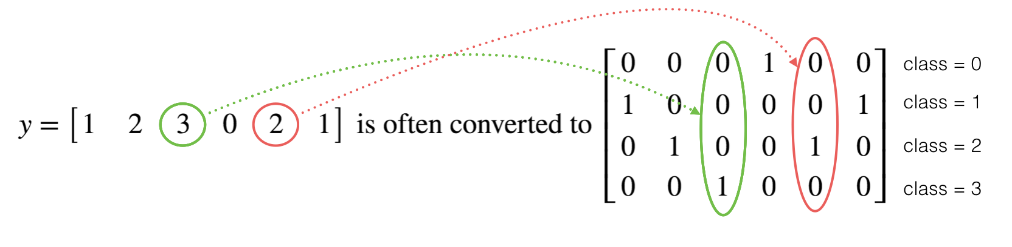
Model Architecture
One-Hot Encodings

Slide 5
Model Architecture
First Neural Network
Hidden Layers
Input Layer
a₁^{[1]}
a₁^{[2]}
a₁^{[3]}
a₁^{[4]}
Output Layer
a₂^{[1]}
a₂^{[2]}
a₂^{[3]}
a₂^{[4]}
X
a^{[5]}
Ŷ
a₃^{[1]}
a₃^{[2]}
a₃^{[3]}
a₃^{[4]}
a_{n1}^{[1]}
a_{n2}^{[2]}
a_{n3}^{[3]}
a_{n4}^{[4]}
X = A^{[0]}
A^{[1]}
A^{[2]}
A^{[3]}
A^{[4]}
A^{[5]}

Slide 6
Model Architecture
Larger Neural Network
Hidden Layers
Input Layer
a₁^{[1]}
a₁^{[2]}
a₁^{[3]}
a₁^{[4]}
a₁^{[5]}
Output Layer
a₂^{[1]}
a₂^{[2]}
a₂^{[3]}
a₂^{[4]}
a₂^{[5]}
X
a^{[6]}
Ŷ
a₃^{[1]}
a₃^{[2]}
a₃^{[3]}
a₃^{[4]}
a₃^{[5]}
a_{n1}^{[1]}
a_{n2}^{[2]}
a_{n3}^{[3]}
a_{n4}^{[4]}
a_{n5}^{[5]}
X = A^{[0]}
A^{[1]}
A^{[2]}
A^{[3]}
A^{[4]}
A^{[5]}
A^{[6]}

Slide 7
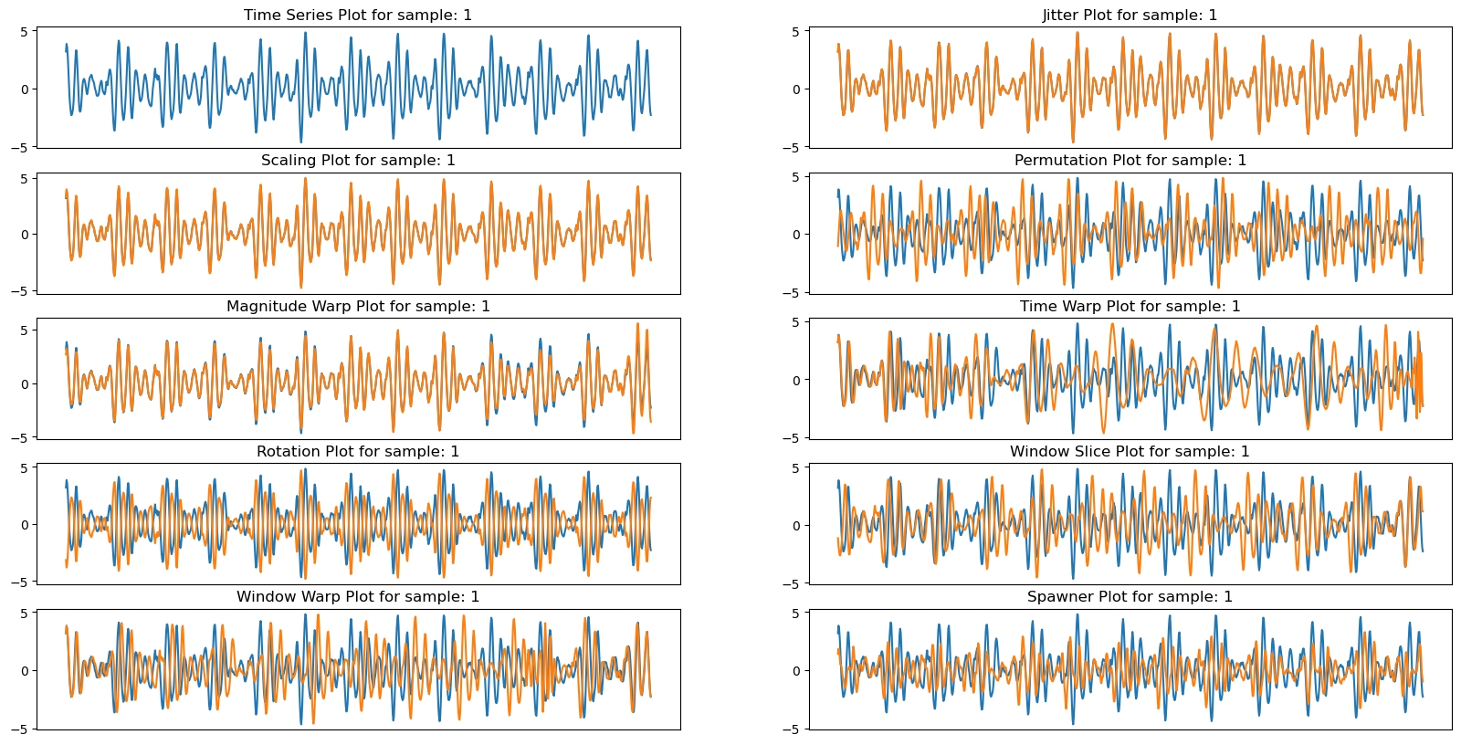
Data Augmentation

Slide 8
Prediction Results
Classifier | Accuracy(On testing set)
First NNM | 0.9604
Larger NNM | 0.9245
Larger NNM Fitting with Data Augmentation | 0.9622

Slide 9
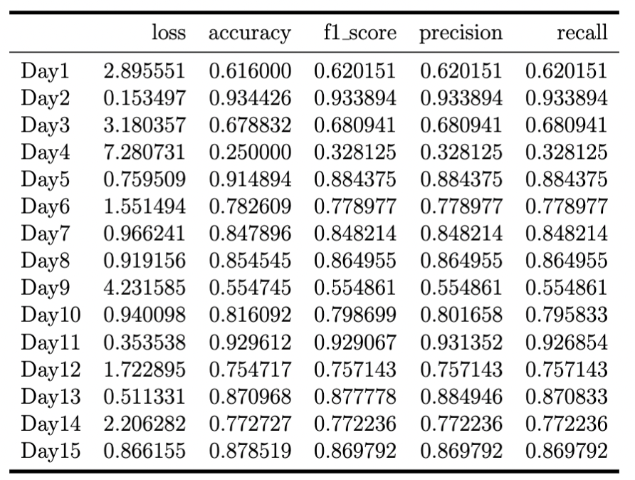
Generalized on Each Day’s Dataset

Slide 10
Performance on the Entire Dataset
Reduce Noise:
Wavelet method
Envelope extraction by Hilbert transform
Smooth Envelope: apply Savitzky–Golay filter
Why not using data augmentation on the entire dataset:
Sample size is enough
Computing resource is limited
Pick up one-day data day by day, then fit NNMs to predict each day’s sleeping posture every 10 seconds. The overall accuracy for 44 day’s prediction result is only 44.59%.

Slide 11
Discussion/Next Week Work
To improve this deep learning supervised system:
Look at the difference between human level error and the training error - avoidable bias.
Look at the difference between the dev/test set and training set error - Variance.
If avoidable bias is large:
Train a bigger model.
Train longer/better optimization algorithm (like Momentum, RMSprop, Adam).
Find better NN architecture/hyperparameters search.
If variance is large you have these options:
Get more training data.
Regularization (L2, Dropout, data augmentation).
Find better NN architecture/hyperparameters search.

